Slide 1
PokéChain: Decentralized PlayToEarn Blockchain based game
I ❤️ Hackathon: <Pune> Web3 Edition
Domain - Gaming
Team Name – Sea King Intern Ships
Mode of Participation - Offline
City Edition of Participation - Pune

Slide 2
About the Team
Kedar Vartak | Team Leader | kedar.vartak22@vit.edu | +91 9325487675
Harsh Badagandi | Team Member | harsh2204@gmail.com | +91 7559105287
Tirthraj Mahajan | Team Member | tirthraj2004@gmail.com | +91 8767945245

Slide 3
Theme and Problem Statement
Theme – Gaming
Problem statement - Creating games using blockchain technology. Explore the potential of play-to-earn and decentralized gaming.

Slide 4
Proposed Solution
PokéChain aims to revolutionize the traditional trading card game (TCG) experience by Web3 technologies and dynamic NFT evolution. The proposed solution addresses several key challenges in the blockchain and NFT gaming domain, enhancing player engagement, ownership, and economic sustainability
True Digital Ownership: By utilizing ERC-1155 tokens, players gain true ownership of their digital cards, which can be verified on the blockchain. This ensures that players have control over their assets without the risk of arbitrary changes by game developers
Verifiable Scarcity: Each card's uniqueness is secured through blockchain technology, allowing players to verify the scarcity and authenticity of their cards
Staking for Training: Players can stake their cards to train them, which not only enhances the card's abilities but also contributes to a "train-to-earn" model
Smart Contract Infrastructure: The use of smart contracts automates game mechanics such as battles, rewards distribution, and card evolution. This transparency reduces the potential for fraud and ensures that all players are treated fairly based on established rules

Slide 5
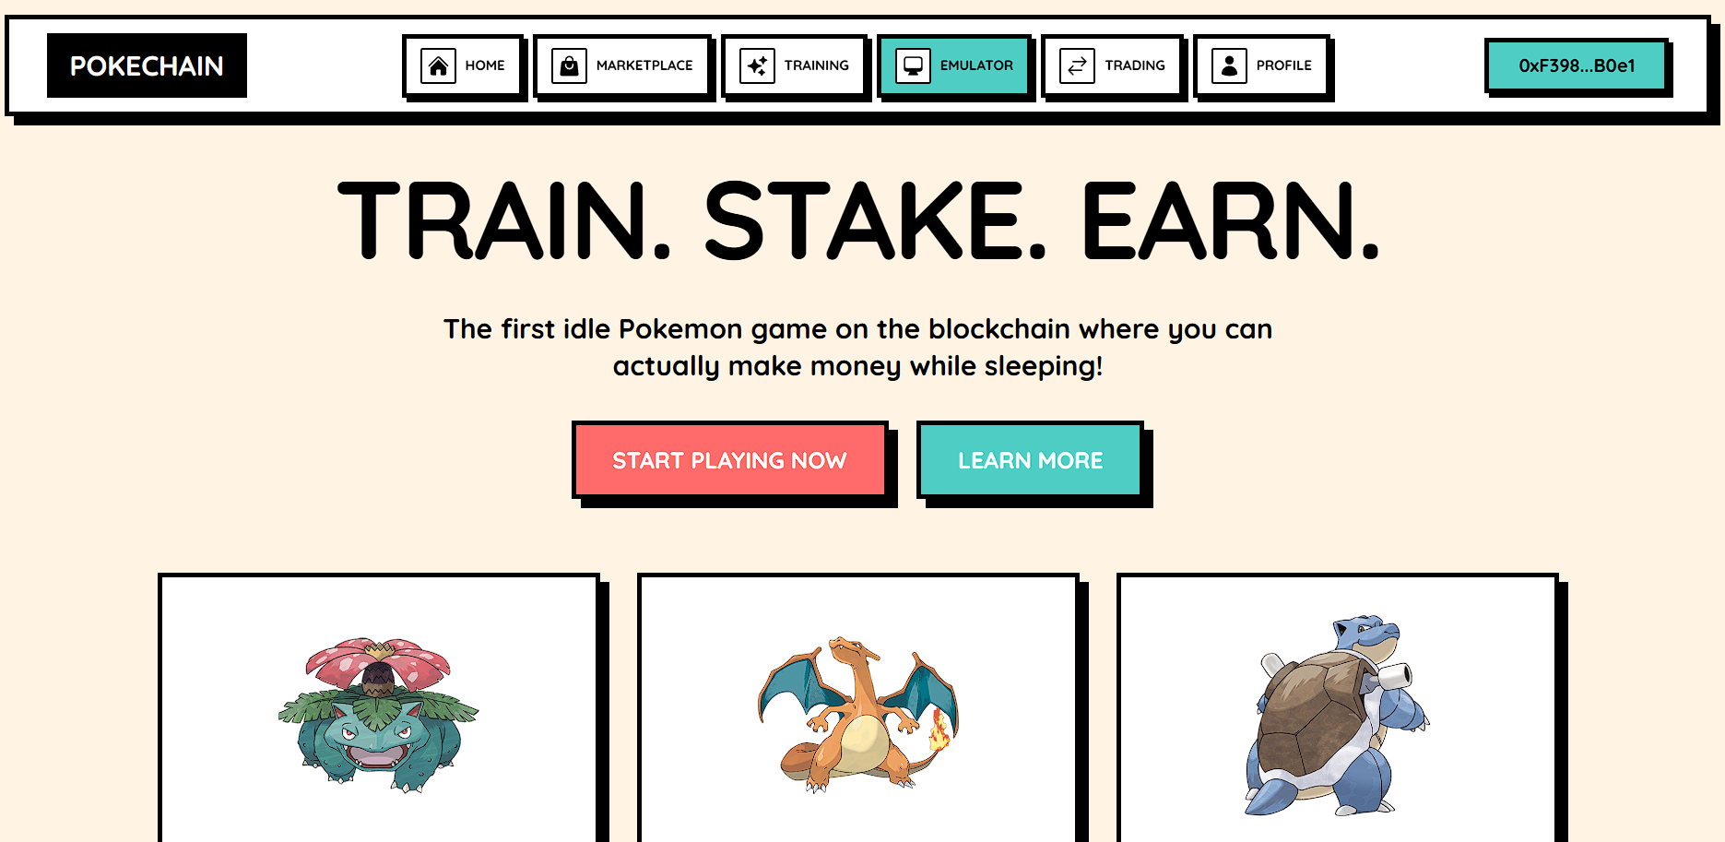
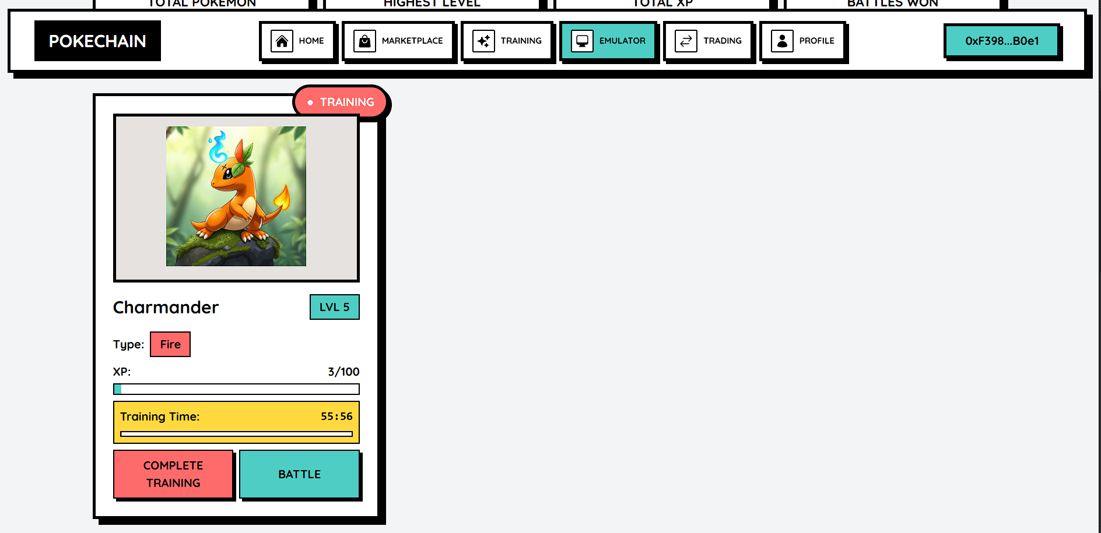
Proposed Solution
Core Features
Wallet-Based Authentication: Players can authenticate using crypto wallets, ensuring secure access to their accounts and assets.
Starter Pack Distribution: A system for distributing starter packs allows new players to enter the game easily while maintaining a balanced economy.
Point-Based Reward System : Players earn points through battles and staking, which can be redeemed for in-game items or upgrades, promoting ongoing participation.

Slide 6
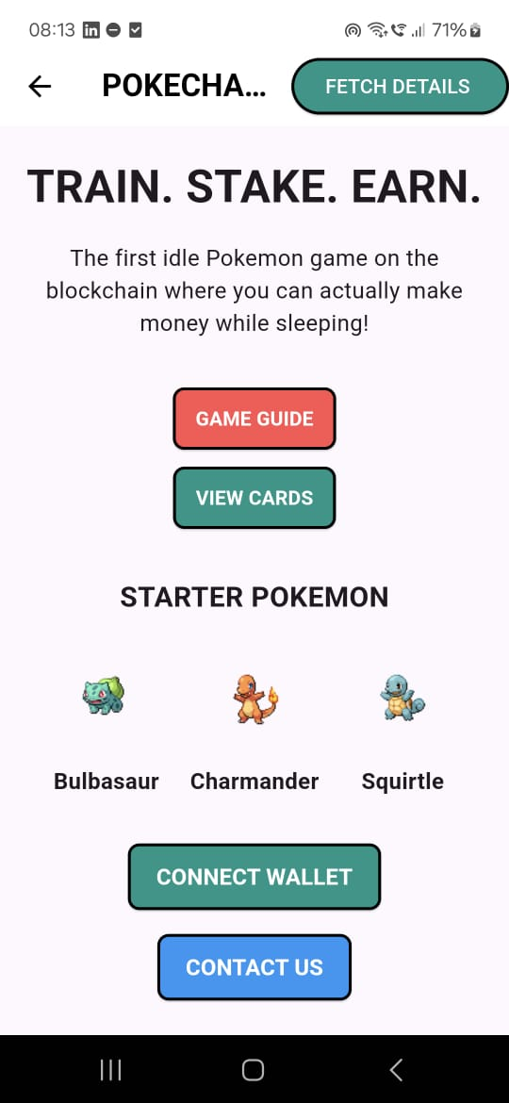
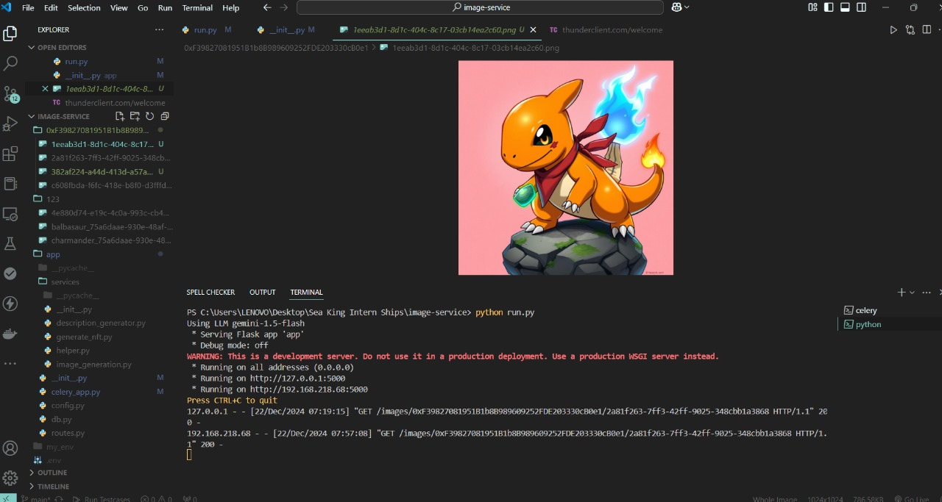
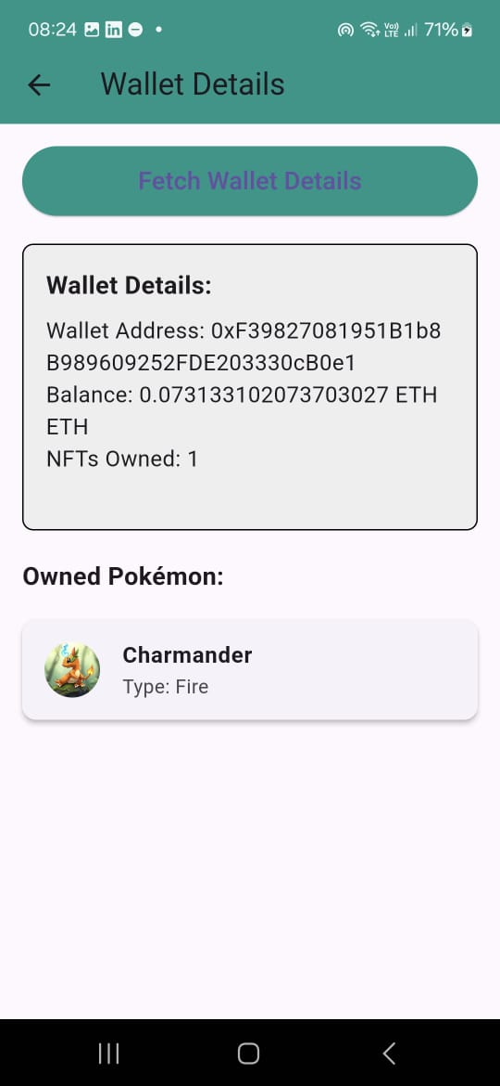
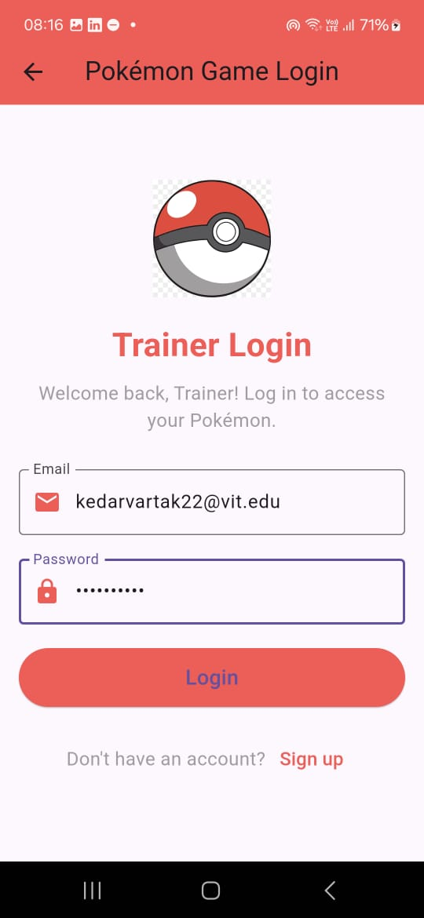
Proposed Solution
Helper Mobile App
AI Image NFT Generator

Slide 7
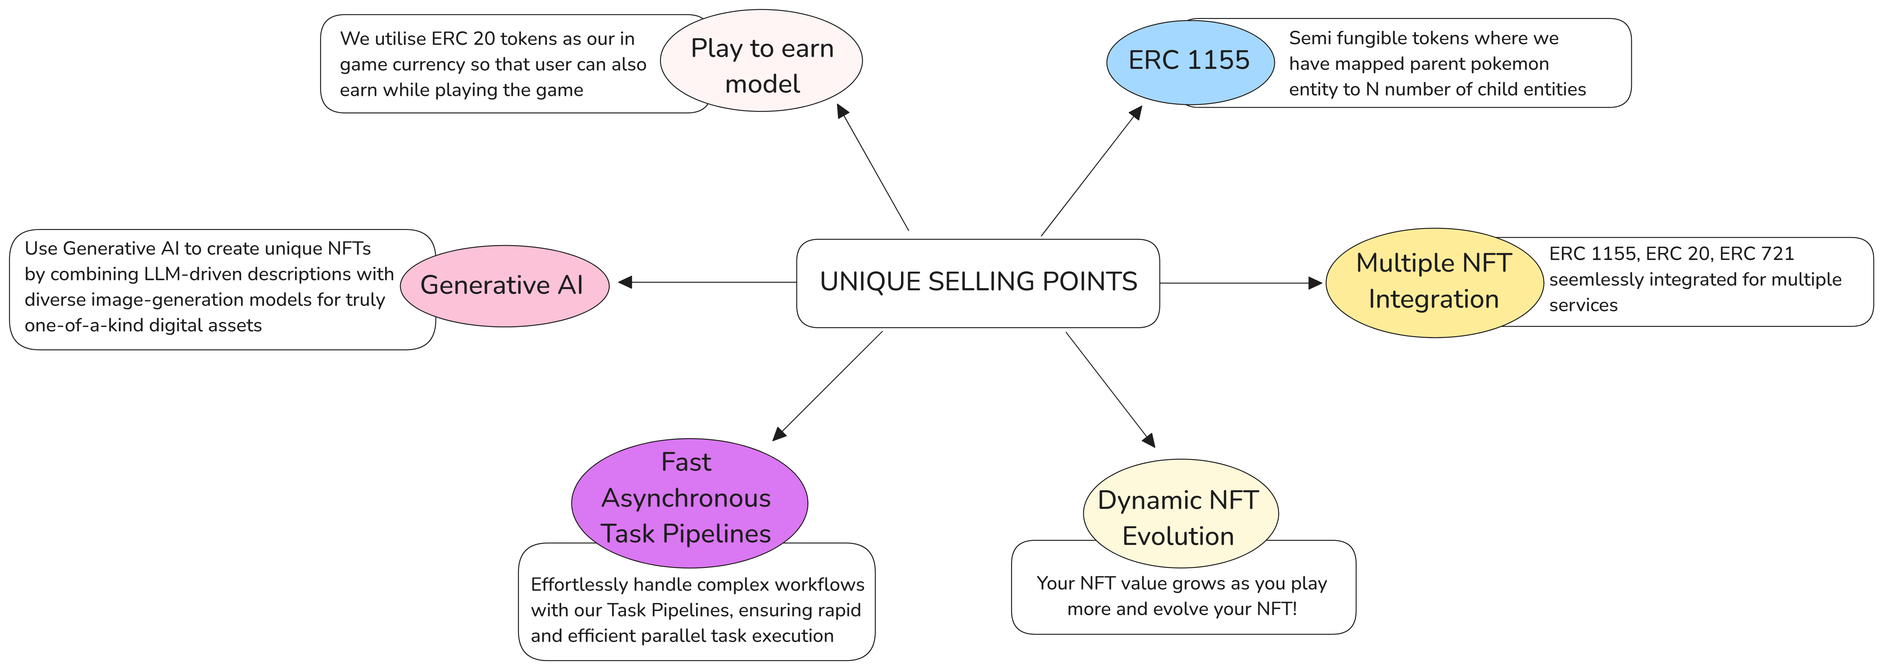

Slide 8
Architecture
Core Technologies used –
React.js - Frontend library for building modular UI components.
Web3.js - Connects the app to Ethereum blockchain.
Node.js & Express - Backend server for handling APIs and app logic.
Linea Blockchain (Ethereum) - Layer 2 blockchain for secure and low-cost transactions.
ERC-1155 - Ethereum token standard for creating NFTs and semi-fungible assets.
Ethers.js - Library for blockchain interactions and smart contracts.
MetaMask - Wallet for authorizing transactions and connecting users to dApps.
Hugging Face - AI models for generating Pokemon cards and sprites.
Hardhat - Smart contract development, testing, and deployment tool.
Flutter – Created an helper app for our actual game system which displays stats and necessary functionalities
Unity – Game engine on which we have created our battle game functions

Slide 9
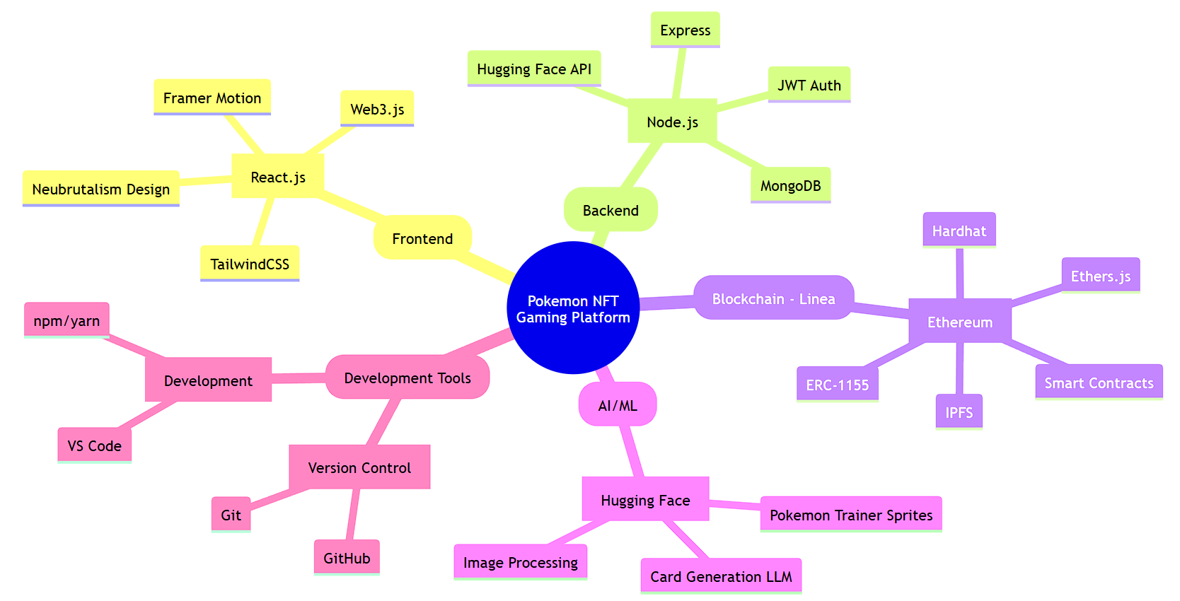
Architecture – Tech Stack

Slide 10
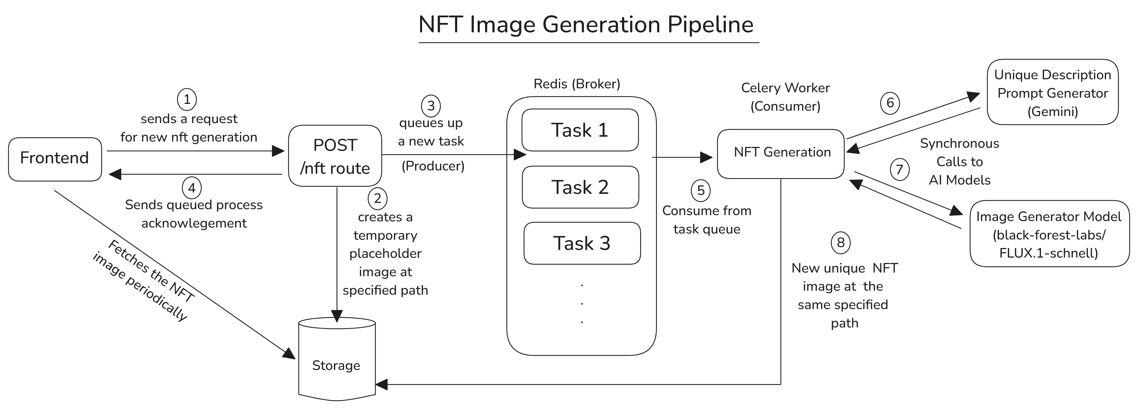
Architecture – AI NFT Image Generator

Slide 11
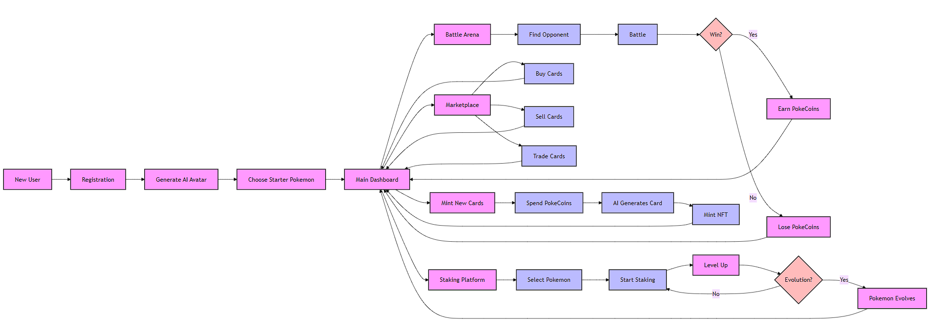
Architecture – Flow Diagram

Slide 12
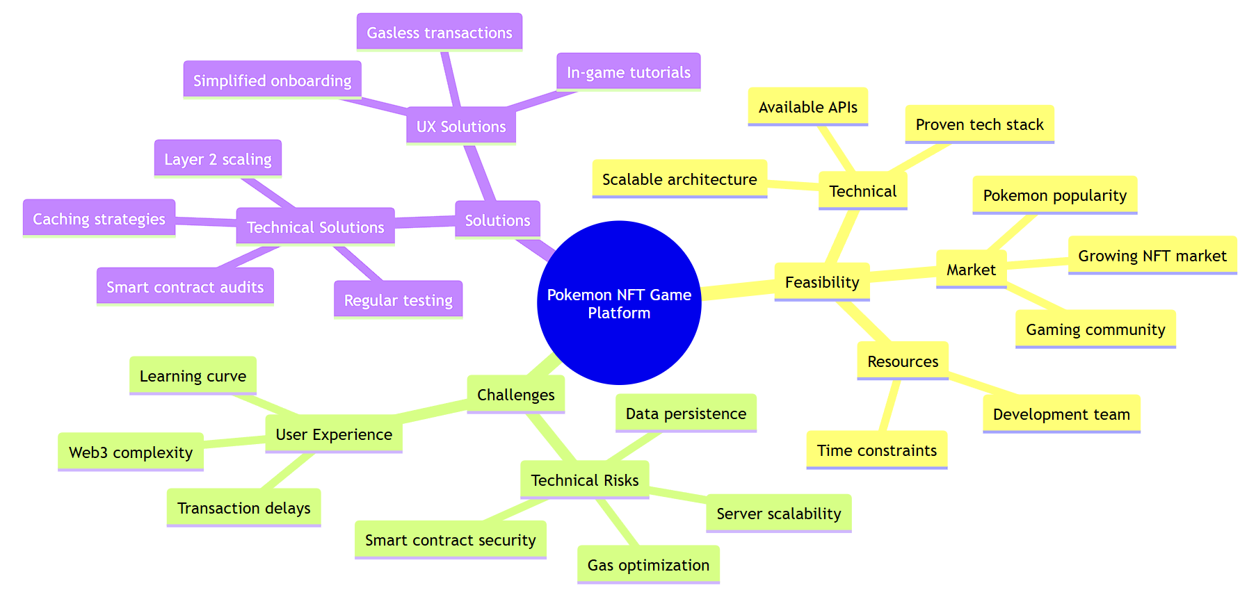
What makes your project innovative/unique?
The system uses well-established technologies, The Feasibility, the challenges and the solutions to overcome the challenges are presented below

Slide 13
Impact of the project
Gaming Revolution
Merges Pokemon gaming with blockchain, giving players true ownership of their cards through NFTs. Players aren't just playing – they're investing in digital assets they actually own.
Real Value Creation
Players earn through battles, trading, and staking. Our play-to-earn model means time spent in-game translates to real value through PokeCoins and valuable card trading.
Community Focus
Builds a vibrant ecosystem where Pokemon fans trade, battle, and interact. The marketplace and battle system create an engaging social platform for players worldwide.
Technical Innovation
Uses ERC-1155 tokens for efficient, cost-effective card management. This means lower fees, better trading, and a smoother player experience.
Unique Content
AI-generated card artwork ensures every player's collection is special. Combines AI creativity with blockchain permanence for truly unique digital collectibles.
Future Gaming
Introduces mainstream gamers to Web3 through a familiar, beloved franchise. Makes blockchain technology accessible and fun through Pokemon gaming.

Slide 14
Thank you!

